Slide 1
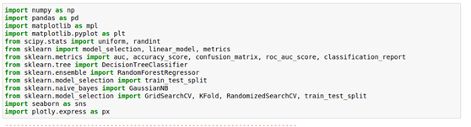
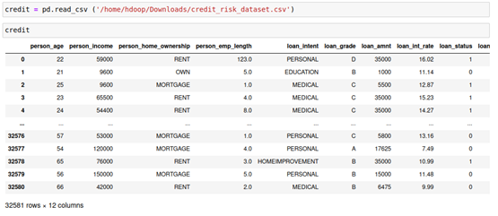
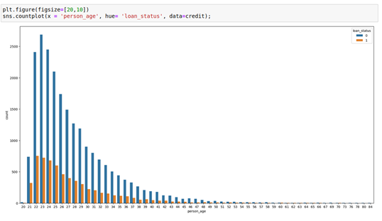
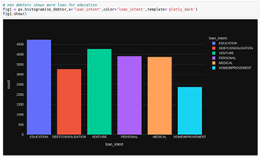
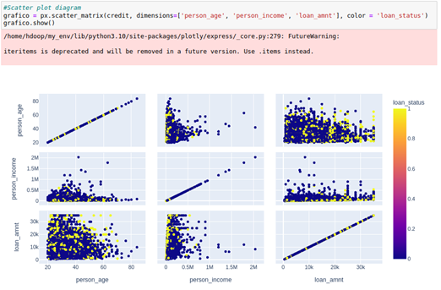
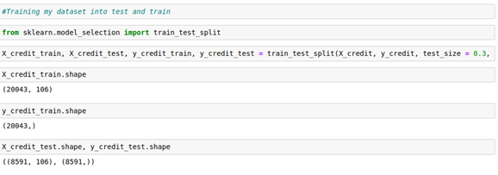
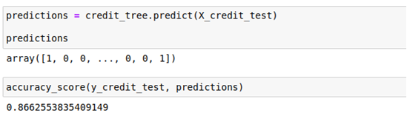
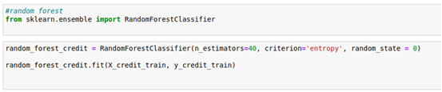
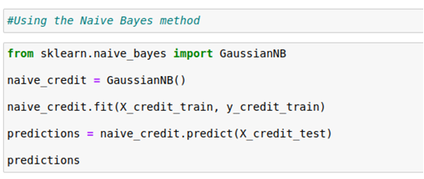
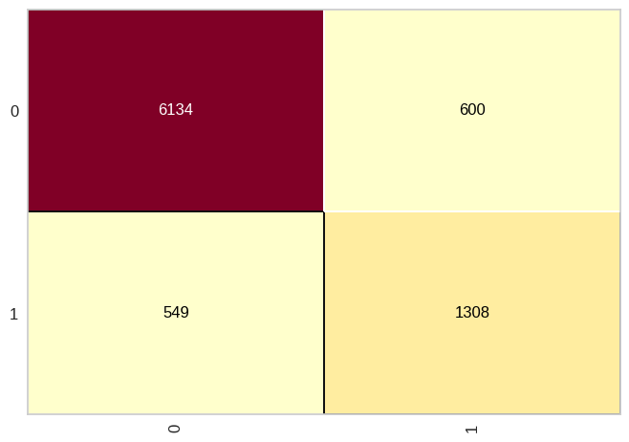
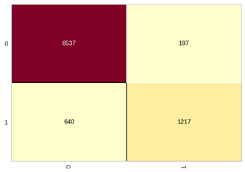
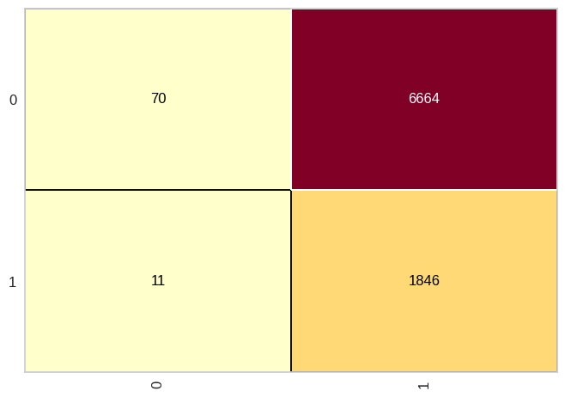
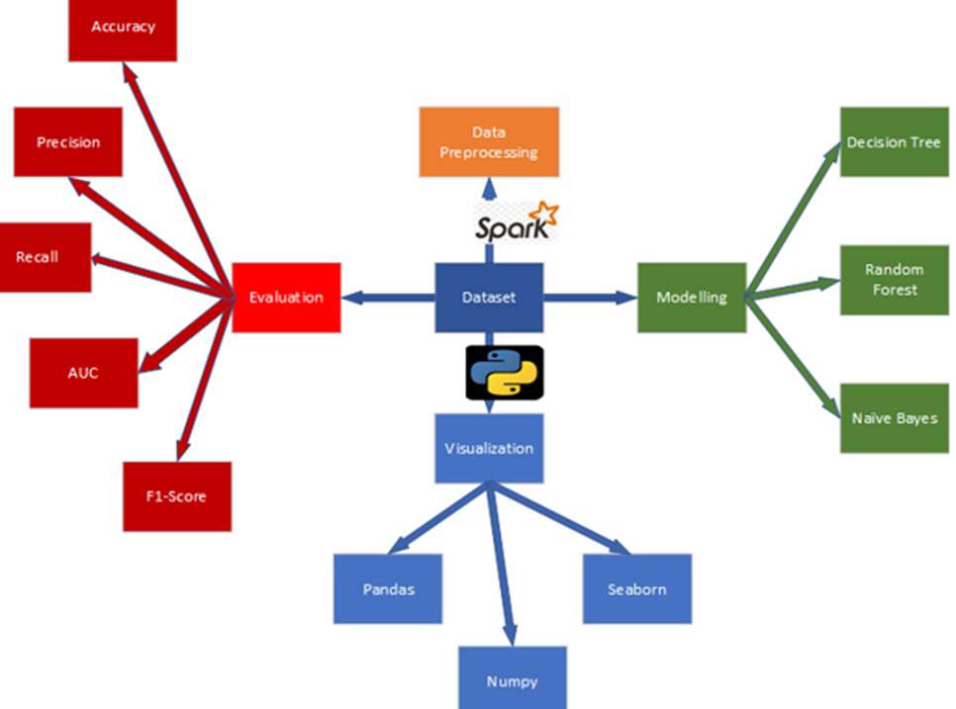
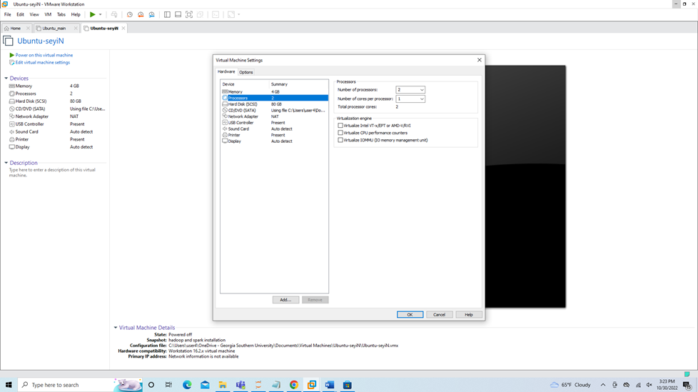
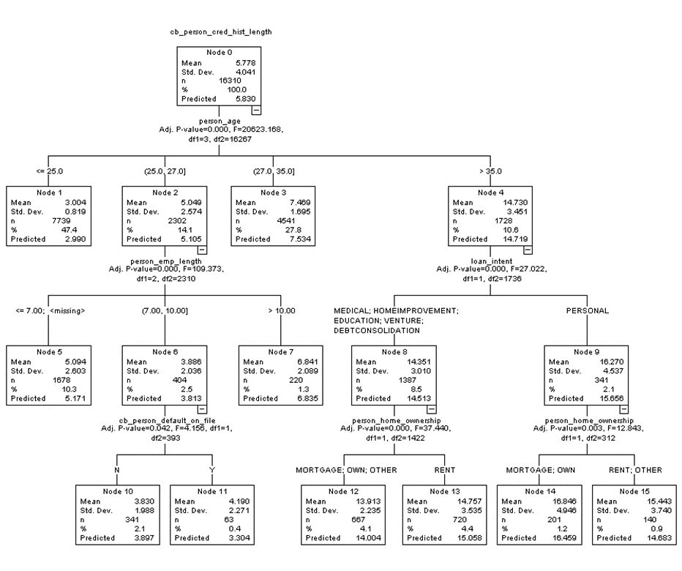
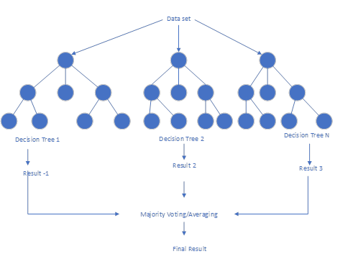
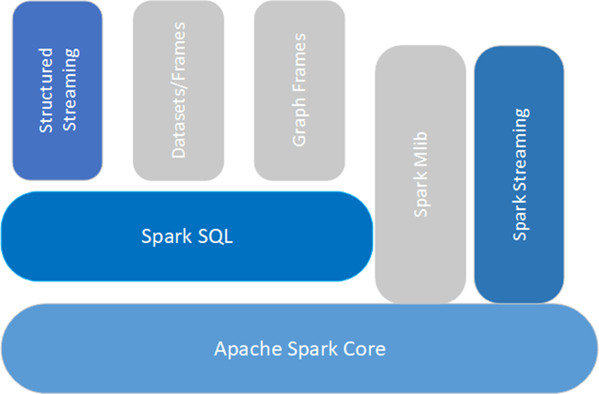


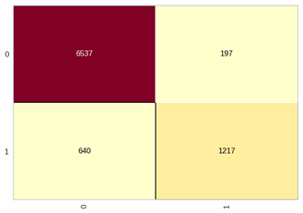
Effective Credit Risk Management in Finance using Big data Ijogun Oluwaseyi A. Department of Information Technology Faculty Mentor: Dr. Hayden Wimmer
Your poster number here
Introduction
Financial institutions are faced daily with high rates of non-performing loans because of the inability to accurately predict defaulters before the disbursement of loans, this has led to many failures and the eventual collapse of some financial industries particularly the banking industries. The bank’s profitability depends on how well it’s able to minimize nonperforming loans called bad debt. Through effective credit risk management, banks can predict, analyze, and mitigate the possibility of non-performing loans, which would greatly improve their profitability. Predicting loan repayment in the past has been a very exhausting task which has been greatly done through traditional methods such as calculated risk analysis through credit scoring and risk profiling methods, this has not effectively prevented and predicted risk because of the dynamic nature of defaulters.
The objective of this research is to reduce the level of non-performing loans in the banking industries, by effectively predicting the probability of default using past customer records such as personal income, loan amount, interest rate, default rate, loan purpose, loan intent, loan status etc, to give a meaningful insight using different machine learning algorithm for proper decision making. This model would serve as a guide to determine customers' behavior toward loan repayment and further categorizes customers into defaulter and non-defaulter by finding the relationship between each independent variable.
For business continuity, a proper understanding of business models through data analysis is imperative for business sustainability and competitive advantage. Financial institutions can significantly maximize profit and establish a good borrower to lenders relationship by mitigating credit risk using big data. The traditional method of taking the calculated risk from customer profiling can be greatly eradicated with the emergence of big data technology using machine learning algorithms. The term "machine learning techniques" refers to a variety of software tools that may turn data sets into "models," which are able to represent the data set and generalize it in order to make predictions about new data. Machine learning models are generally classified into dependent variables and independent variables. In general, the independent variables are the many elements that influence the outcome of the prediction and are used as the model's input. The dependent variable refers to the target of the prediction and is used as the output of the model. The result showed the different machine learning outputs for the various algorithm such as Decision tree, Random Forest, and Naïve Bayes and suggested the best algorithm based on its accuracy, recall, and precision. However, there is no generally best model for the algorithm. The different models are expected to perform differently based on the type of input dataset.
Results and Findings
Fig 6.0
Fig 7.0
Fig 8.0
Preliminary Work
Multiple research has been done to predict, classify, and model the effect of machine learning using different performance index.
Zhao (2021) studied Big Data Financial Algorithm Technology Based on Machine Learning Technology. He utilized the training dataset using MACD (Moving average convergence divergence algorithm. The result showed that machine learning algorithm with big data gave a strong interpretation to find the users behavior.
Peng (2019) Studied Stock Analysis And Prediction Using Big Data Analytics. He utilized machine learning using linear regression by finding the correlation between the stock prices, the result found the R-squared and mean average which showed there was a positive correlation between the stock prices .
Yadav and Thakur (2017) proposed Bank Loan Analysis Using Customer Usage Data: A Big Data Approach Using Hadoop, He studied the use of Hadoop using a virtual machine. The data was injected into the HDFS for storage and further analysis. Apache Hive was used to manage and refine the data, the result shows that a higher probability for borrowers to get loan and investors to get higher interest with lesser risk based on the inputted dataset.
Ananthu et al. (2021) studied Credit Card Fraud Detection using Apache Spark Analysis. He identified fraudulent transactions by analyzing the previous set of transaction using big data. He used spark for fast detection of large real-time data. Then used yarn as the cluster manager using a supervised learning, the result shows that apache spark algorithm was faster approach as compared to Hadoop and Map reduce. The author also compared different machine learning algorithm namely decision tree classifier, logistic regression and random forest.
Fig 9.0
Fig 10.0
Fig 11.0
Fig 12.0
Fig 13.0
Fig 14.0
Machine Learning Results Decision Tree Random Forest Naïve Bayes
Precision 92% 91% 86%
Recall 91% 97% 1%
F1-Score 91% 94% 2%
Accuracy 87% 90% 22%
Fig 15.0
Methodology
A data pipeline is used to explain the methods, which shows the sequence of steps in arriving at a successful prediction result. Credit risk management is a classification problem where the financial institution is determining whether customers would default or not in the payment of a loan. It’s either the customer defaults called 1 or is a non-defaulter called 0 in the machine learning sequence. Big data can be used to predict a long range of problems such as cancer detection, virus attack detection, and financial prediction. The dataset is first stored in the HDFS to enable the machine learning process, then a comma-separated variable file (CSV) is imported on the spark environment using jupyter notebook, where further processing is done. A series of data preprocessing was done using Apache spark as the processing engine. The modeling was done using machine learning algorithms such as Decision Tree, Random Forest, and Naïve Bayes on a spark library such as Pandas for cleaning the data, NumPy used for mathematical calculations, and seaborn used for visualization. The proposed method would be used for early prediction of bank customers defaulting in repayment of loans based on machine learning algorithms and ensemble learning techniques. The model is composed of the following stages, Data Understanding, Data preparation, Data loading, Machine learning modeling, and evaluation.
The classification technique would involve using machine learning algorithms that would learn how to assign classes from a problem domain into a class model. The model used for my classification technique is multi-class classification which involves algorithms such as decision trees, Naïve Bayes, and Random Forest. A supervised learning model was used to see how well the model would perform. A model validation process was used called the split-train and test model were used to train the dataset. The first step in the machine learning process is to arrange the data into an acceptable split train model. In pyspark, the command to import the machine learning language is called the Scikit-learn where the data is separated into the “features” and “Targets”. Decision tree, Random forest and Naïve Bayes algorithm are deployed from python’s scikit-learn library using pyspark. The algorithm is been able to run on HDFS successfully through its remote access using the internal IP of the Master node. The data set was split into two pieces namely, the Training set and the testing set, by randomly selecting the samples of data without replacement. A ratio of 70% (0.7) of the rows would be put into my training set, and the remaining 30% (0.3) would be put into my test set ( “X-train,” “X-test”, “Y-train”, “y-test”). The Train model involves building and training the model on the predictive model. It is denoted with “X_test” and “Y_test”). Then the model was tested with (“X_test” and “Y_test”) and the performance is evaluated using the machine learning algorithm such as Decision tree, Random Forest, Navies Bayes and the result is indicated. Below.
Discussion
In the figure above fig 6.0 shows the code I used in importing my machine learning algorithm from pyspark such as numpy, pandas, matplotlib, sklearn etc for processing of my dataset. The second figure 7.0 shows where I imported my dataset from my HDFS, the result shows 390,984 observations with 12 rows and 32,582 columns. Some preprocessing steps were used to remove attributes of extreme values. Fig 8.0 and 9.0 shows the relationship between each of the dependent and independent variables in a visualized format, comparing the impact of customers spending on the loan default. Fig 10.0 represented the relationship in a scattered plot showing the individual results based on the dataset inputted. Figure 11.0 shows the codes used in training my dataset into train-split-test where I used the ratio 70:30 in training the dataset and getting the appropriate result. The subsequent figures shows the different machine learning algorithm such as decision tree, random forest method, and naïve bayes algorithm, the different codes used in deriving the result was as well summarized in fig 15.0. The confusion matrix shows the classification of the model defaulters where denoted with non-defaulter called 0 and defaulter with 1. The TP( True positive) and TN (True Negative) were taken for the prediction where decision tree had a defaulter of 6134 and a non-defaulter as 1308. the random forest had a defaulter of 6537 and a non-defaulter of 1217. the naïve bayes algorithm gave a defaulter of 70 and non-defaulter of 1846. The summary of the machine learning algorithm is shown in Fig 15.0 the table above shows the performance metrics results of the three classifiers used. The Random Forest ensemble machine learning techniques gave a better result than the rest of the models. The Random Forest technique had an accuracy of 90%, an F1 score of 94%, a precision of 91%, and a recall of 97% as compared to other results from the machine learning algorithm. It shows that the ensemble machine-learning techniques had a better performance according to the result shown above.
Methodology or Approach
Fig 16.0 shows the confusion matrix for decision tree machine learning algorithm
Fig 17.0 shows the confusion matrix for random forest
Fig 18.0 shows the confusion matrix for Naïve Bayes algorithm
Top findings
The research above shows that big data using Spark was able to classify bank customers into defaulters and non-defaulters
It also shows that a supervised machine learning algorithm could be used to measure the accuracy, precision, recall, Area under curve, f1 and to predict the likelihood of customers repayment of loan.
Among the machine learning algorithm used, such as Decision tree, Random Forest, Naïve Bayes, the Random Forest gave a better result among the different machine learning algorithm used based on the dataset imported.
Importance of this research
This work is important to improve the banks profitability and sustainability by reducing the amount of non-performing loans in the banking industry by effectively predicting the probability of default using customers past records to give meaningful insight using different machine learning algorithm for proper decision making. Future work would be done to implement the use of this algorithm in a real time scenario.
Fig 1.0 shows the data pipeline for the entire research work done
Fig 2.0 shows my virtual machine and its specifications
References
Yadav, S., & Thakur, S. (2017). Bank loan analysis using customer usage data: A big data approach using Hadoop. 2017 2nd International Conference on Telecommunication and Networks (TEL-NET),
Zhao, Y. (2021). Big Data Financial Algorithm Technology Based on Machine Learning Technology. 2021 International Conference on Aviation Safety and Information Technology,
Ananthu, S., Sethumadhavan, N., & AG, H. N. (2021). Credit Card Fraud Detection using Apache Spark Analysis. 2021 5th International Conference on Trends in Electronics and Informatics (ICOEI),
Peng, Z. (2019). Stocks analysis and prediction using big data analytics. 2019 international conference on intelligent transportation, big data & smart City (ICITBS),.
Acknowledgments
Profound gratitude to my professor and mentor Dr Wimmer for his guidance and support throughout the course of this research
Fig 3.0 shows Apache spark Architecture
Figure 4.0 shows my sample decision tree model using SPSS
Figure 5.0 shows my Random Forest Diagram
2023 Student Research Symposium
Statesboro, Georgia
April 21, 2023

